Slide 1
Machine Learning PoC for The EIU
Seminar Group 2
Team 7
Group Members:
Gabriella Angelina Lim (U2010230J)
Justyn Phoa Zairen (U2022593D)
Leow Ken Hing Bryan (U2021729K)
Rodmond Tan Le Meng (U2022791E)

Slide 2




Meet the team!
Gabriella Angelina Lim
Justyn Phoa Zairen
Leow Ken Hing Bryan
Rodmond Tan Le Meng
Angel

Slide 3
1.
Introduction
Angel

Slide 4

1946
Forecasting & Advisory
Entrepreneurs, Financiers & Government Officials
Founded
Services
Users
Angel

Slide 5
Business Problem
ECONOMIC GROWTH FORECASTS ACCURACY
)
(
% Changes in GDP
Education
Indicators
Machine Learning
Angel

Slide 6
Significance of Business Problem
EIU’s Credibility
Inaccurate Predictions
Angel

Slide 7
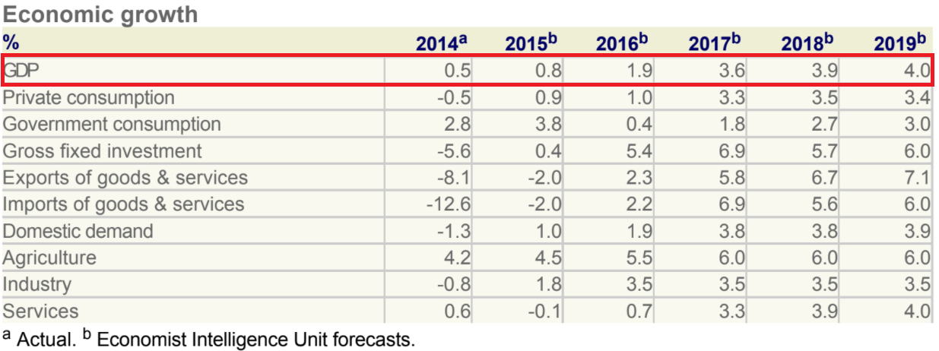
Justification of Business Problem
Forecast GDP Growth
HUGE Discrepancy
Actual GDP Growth
Angel

Slide 8
EIU Indicators
Industrial
Production & Exports
Economic Conditions in Neighbouring Countries
Wages
Government Macroeconomic Policy
Consumer
Confidence
Angel

Slide 9
EIU Indicators Vs. Education Metric
1. DIVERSITY
EIU Indicators | Education as Indicator
Cyclical Change with varying economic outlooks Influenced by policymakers | Systemic More permanent in policy stance
2. CAUSALITY
Causal relationship between education and a country’s economic development
Angel

Slide 10
EIU Indicators Vs. Education Metric
3. PREDICTABILITY
EIU Indicators | Education as Indicator
Risky and subjective assumptions E.g. Assumptions about government’s macroeconomic policies and the direction they will take the country Possible biases & blindsides | Trend more predictable E.g. adult literacy rates consistently increase over the years (World Bank data)
Angel

Slide 11
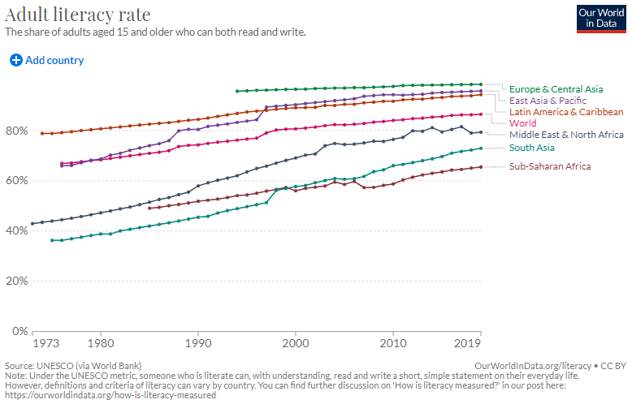
EIU Indicators Vs. Education Metric
3. PREDICTABILITY
Angel

Slide 12
Machine Learning Opportunities
Machine Learning | Non-Machine Learning
Prediction-oriented | Interpretation-oriented
Programmed to learn to perform a task | Programmed to perform a task
Can deal with large datasets with dozens of variables | Less flexible in dealing with intensive data
Angel

Slide 13
Case Studies
1. FORECASTING ECONOMIC RECESSIONS (Cicceri et al., 2020)
Non-ML → inaccurate predictions of GDP growth before recessions (episodic and non-linear)
ML technique → Linear Regression Model and a Nonlinear Autoregressive with exogenous variables (NARX) model
Able to manage large volumes of data
Able to correlate multiple data without human assistance
Higher accuracy
Result: The NARX model was able to correctly forecast the 3 recessions that occurred and also the strength of these events during that time period
Angel
Notes:
ML models outperformed the traditional statistical models, with a higher degree of R² and a lower Mean Square Error (MSE).

Slide 14
Case Studies
2. FORECASTING BUSINESS TO BUSINESS SALES (Rohaan et al., 2022)
Non-ML → Manual checking of emails & delays
ML technique → ML and Natural Language Processing (NLP)
Text mining
Priority sorting
Prediction of sales potential
Result: The supervised ML and NLP results to a 155.3% increase in performance as compared to manual handling
Angel
Notes:
RFQs are requests for a quote for spare parts (usually by email) and do not necessarily result in a sale.

Slide 15

Machine Learning Value to EIU
Qualitative Indicators
NLP Techniques
02
Quantitative Indicators
Regression
Decision-Tree
Neural Network Models
Models:
XGBoost
Arima
01
03
Geotagged Images
Image Recognition Techniques
Linear Regression and Classification and Regression Tree (CART) Models
Angel

Slide 16
Live Demo

Slide 17


Tool of Choice
Free
Widely-used for data analysis
RSCRIPT_Data_Cleaning_BC2406S2T7.R
RSCRIPT_Machine_Learning_BC2406S2T7.R
Bryan

Slide 18


Proof-of-Concept Overview
Part One
Part Two
macroeconomic indicators
Educational Metrics
+
PISA Scores
GDP Growth
Bryan

Slide 19

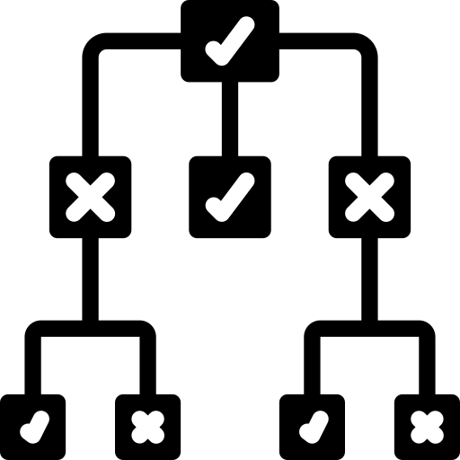

Proof-of-Concept Overview
Linear
Regression
CART
(number)
(number or category)
Bryan

Slide 20





Data Cleaning
An iterative process
Is the
data clean
enough?
Fill missing NA values?
Remove column? (>80% NA?)
Bryan

Slide 21
Adjusted R2
RMSE
“Explainability”
“Error Margin”
MODEL OVERFITTING
a good model is…
simple
effective
Bryan

Slide 22
In machine learning...
Do things stepwise
Understand your data (through plots)
Linear regression (Y = aX) assumptions:
No predictor variables are too related
Y linearly related to X
Error margins are randomly spread
Error margins do not depend on X
Bryan

Slide 23
POC Part 1: Findings
PISA can be accurately predicted from educational metrics
CART performs better than linear regression and does not require assumptions
Bryan

Slide 24
GDP Modelling
Justyn

Slide 25
Data Processing
Lagging GDP data by 1 year
Justyn

Slide 26
Choosing Predictor Variables
Only use Education?
Too complex
Include economic predictors
Justyn

Slide 27


Absolute ~ % Growth
Absolute ~ Absolute
Justyn

Slide 28
Absolute ~ % Growth
Absolute ~ Absolute
% change ~ % Growth
Justyn

Slide 29
% Change calculations
2008
PISA score: 300
2009
PISA score: 330
% increase in 2009: 10%
Justyn

Slide 30
Still too complex
Education + Macroeconomic
GDP Growth
Justyn

Slide 31
Negative
Positive
Education + Macroeconomic
GDP Growth
Justyn

Slide 32
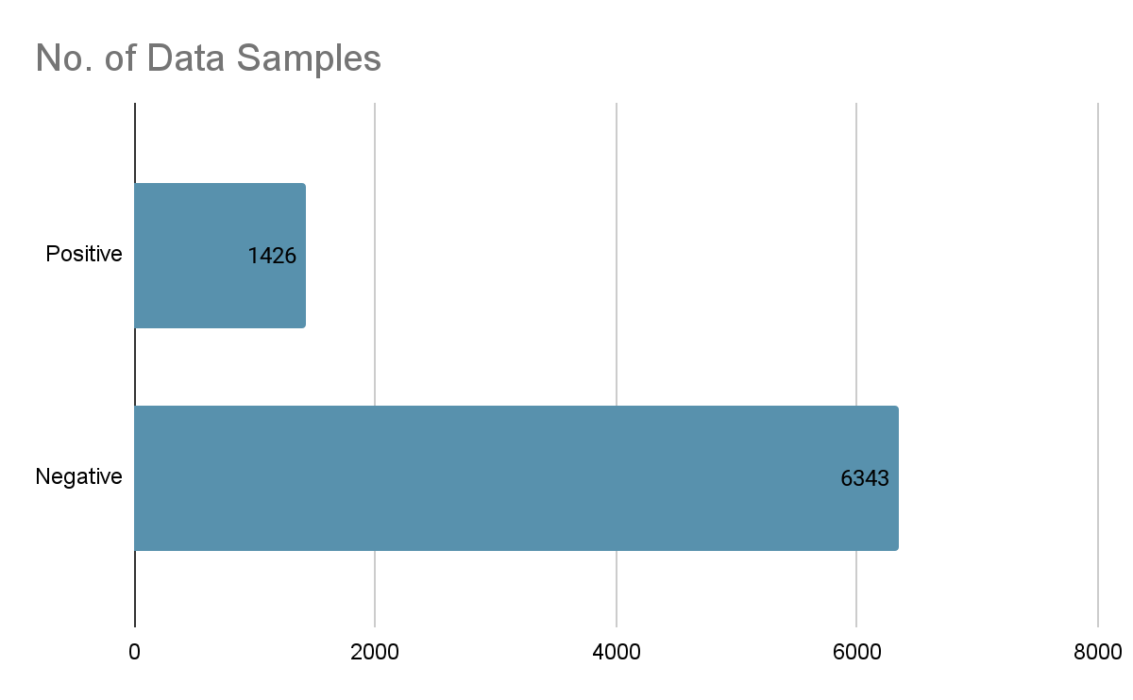
Imbalance in Classification
SMOTE
Justyn

Slide 33
Conclusion
Rodmond

Slide 34
Overall Results
 | EIU’s current models | Our ML Model | Difference
Correctly Predicted positive growth | 67% | 70% | +3%
Correctly Predicted negative growth | 32% | 42% | +10%
Overall Accuracy | 52% | 57% | +5%
Rodmond

Slide 35
Our Recommendations
Pilot Study
Start by using our model and insights together with EIU’s data and assess its accuracy compared to its other prediction techniques
Further Exploration
Use other more advanced machine learning models and explore the predictive accuracy each models bring
Integration
When EIU is satisfied with the tested benefits that machine learning brings, it should set up a team dedicated to machine learning and integrate it with its other prediction methods
Rodmond

Slide 36
Machine Learning Pilot
Data Collection and cleaning
Model training using machine learning on data
Prediction using trained models
1
3
5
2
4
6
Data Exploration and initial assessment
Model evaluation and assessment
Compare with other predictive techniques used by EIU
Rodmond

Slide 37
A breakthrough in machine learning would be worth ten microsofts
Bill Gates
Rodmond

Slide 38
Thank You!

